Slide 1
Cancer Biology Biol 445
Spring 2020
Dr. Heidi Super
Lecture 25
4-3-2020

Slide 2
Announcements
Topics list---quiz 4
Quiz 4---Available 11:00 am-12:30 pm, Monday April 6th. Cancer Biology BB homepage.
If you have obligations in that timeframe, please let me know. I am flexible. Anyone who can, is trying to work—especially in healthcare…I understand.

Slide 3
Checking in….
Thanks for checking in with the BB collaborate system.
We can meet anytime, that way to go over lectures. We could even do live lectures that can be recorded, if you would like to do that.

Slide 4
Where were we?
A student had a question about aflatoxin and a slide from last lecture.
Aflatoxin is produced by Aspergillus, a mold which is common on grain and nuts.
Highly mutagenic/carcinogenic
It’s inhibition by synthetic by synthetic pesticides in developed countries likely outweighs the risk of ingesting the pesticide!
My point was—aflatoxin is the most potent naturally-occurring carcinogen. It causes cancer at very low concentrations.

Slide 5
Some people think that “natural” cannot be harmful. Not true---and in the case of something like aflatoxin--we should avoid it!
So treating grain or other foods that might grow the mold/fungus that produces aflatoxin makes sense---even if it means spraying a chemical (fungicide) on the food people will ingest. *my slide said pesticide—sorry. Wrong type of chemical.

Slide 6
Chapter 6—radiation and cancer
Radiation
Any type of energy that can travel.
Heat, sound, cosmic radiation, radio waves, microwaves, visible light, UV light, X-rays, energy emitted from nuclei of atoms.
You are exposed to different forms of essential radiation all the time.
Typically the higher the energy, the more potential for DNA damage and cancer risk.

Slide 7
Correlation
UV—sunlight exposure linked to skin cancer
Much higher incidence in people of light skin (melanin absorbs UV radiation and keeps it from inducing DNA damage)
Much higher incidence in locations of intense, prolonged sun or individuals who intentionally expose themselves to UV (outside, tanning beds)

Slide 8
Sunlight—UV engergy
Sunlight composed of 3 classes/wavelengths of UV energy
UVA, UVB, UVC—in decreasing order of wavelenth.
Most UV reaching the earth is UVA—no filter in earth’s atmosphere.
Lowest energy---requires long-term exposure to cause cancer (tumor promoter)

Slide 9
UVB
Primary wavelength to cause cancer (mostly skin cancer). Figures 6-1, 6-2
Most UVB absorbed by ozone layer of earth’s atmosphere.
UVB that reaches earth surface is responsible for skin tan, burn, aging (dryness/wrinkling), sking cancer

Slide 10
UVC---most dangerous, but does not reach earth at all.
Can be made in artificial light sources. Used to sterilize meat/food and surfaces of medical and research equipment. Tissue culture hood!
Short exposure can burn terribly

Slide 11
UVB
Induces that DNA lesion called Pyrimidine dimer.
Figure 6-4
How is the disease Xeroderma Pigmentosum (XP) connected?

Slide 12
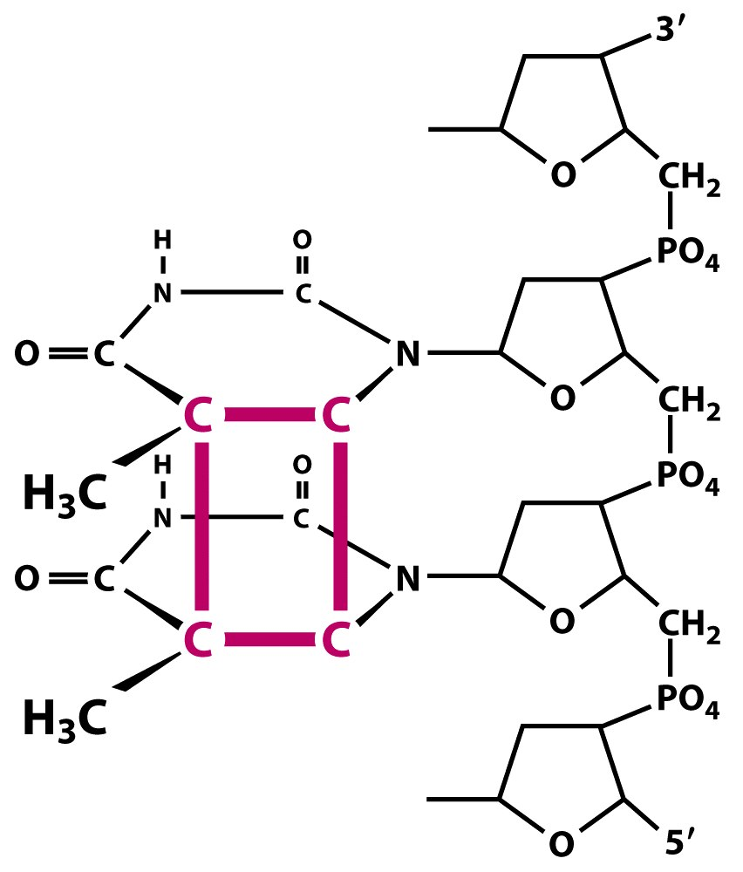
Figure 12.14a The Biology of Cancer (© Garland Science 2007)

Slide 13
Which gene(s) are important in skin cancer?
Non-melanoma---(basal cell or squamous cell carcinoma) routinely shows a “UV signature” with pyrimidine dimer-induced mutations in p53 gene!
Mutations in p53 are non-random changes—affect the coding sequence—change the protein. Figure 6-5 and 6-6

Slide 14
Really important to understand these 2 figures.
We should have a good understanding of the importance of functioning p53 protein.
It is activated to protect cells in a number of ways and it is activated by a number of types of potential mutagens/mutagenic events.

Slide 15
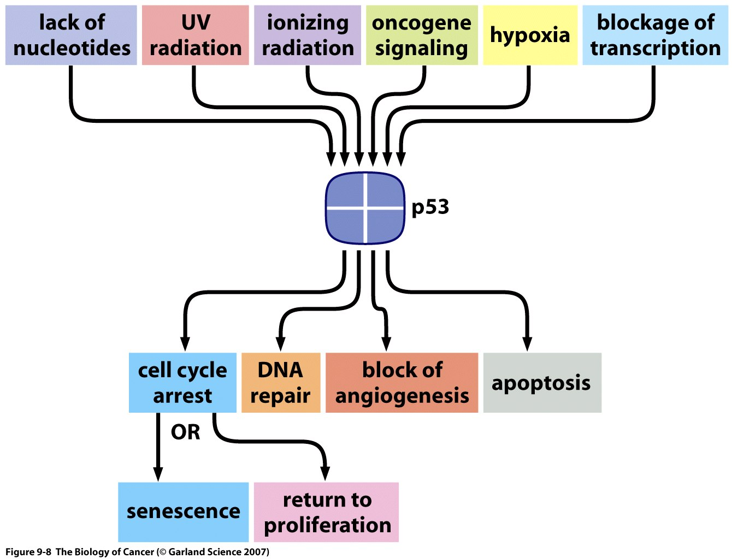
Recall?

Slide 16
But what we see in skin cancers (analysis of the skin cancer cells themselves)
High concentration of mutations throughout the DNA at dipyrimidine sites. (C-C or T-T in the same strand)
When looking at p53 mutations specifically, the type of mutations in p53 are frequently at dipyrimidine sites.

Slide 17
Figure 6-5
Skin cancers show a “UV signature”---including mutations in p53 gene that look like it was hit with UV light.
* Certainly other cancers show loss of function mutations in p53---but not the high rate of mutations at dipyrimidine sites.

Slide 18
Another important point— figure 6-6
By looking at cancer cells….you are selecting for mutations that give cells a proliferative advantage---they are dividing faster than other cells of the same organism.
UV does not “seek out” p53, but when it is hit, and inactivated, cancer is the result. We find the mutations because we are looking at cancer cells.

Slide 19
So what is sunburn?
Acute effect of UVB (energy damages the skin cells/keratinocytes)—some cells dying by necrosis.
More than that…
UVB exposure is followed by apoptosis, triggered by p53. (mice lacking normal p53, don’t experience sunburn)
Ironically UV will damage DNA containing the p53 gene in some keratinocytes-- ignore the DNA damage response. Sets stage for continued DNA damage.

Slide 20
Sunburn is ill-advised!
Excessive sun exposure triggers apoptosis—but this apoptosis would NOT be necessary if the keratinocytes would not have been exposed!
Skin cells triggered in such a way indicate some may have had p53 mutations already

Slide 21
---UVB is a potent tumor initiator.—Previous exposure can manifest as a skin cancer YEARS later.
Estimated that each sunburn of childhood doubles ones chance of developing skin cancer, including melanoma.

Slide 22
Tanning beds…
Most use UVA, but repeated exposure greatly increases the chance of p53 mutation.
--and mutations in other genes associated with melanoma…CDKN2A, BRAF
Tanning is so accepted/encouraged that adolescents have a new addiction category---tanorexia. (and alarming rates of melanoma)

Slide 23
Natural protection mechanisms
Melanin in skin---blocks source of DNA damaging agent. (UV—not chemical)
Cells called melanocytes—transfer vesicles with melanin to keratinocytes. The melanin deposits like an umbrella over the nuclei, shielding them from UV

Slide 24
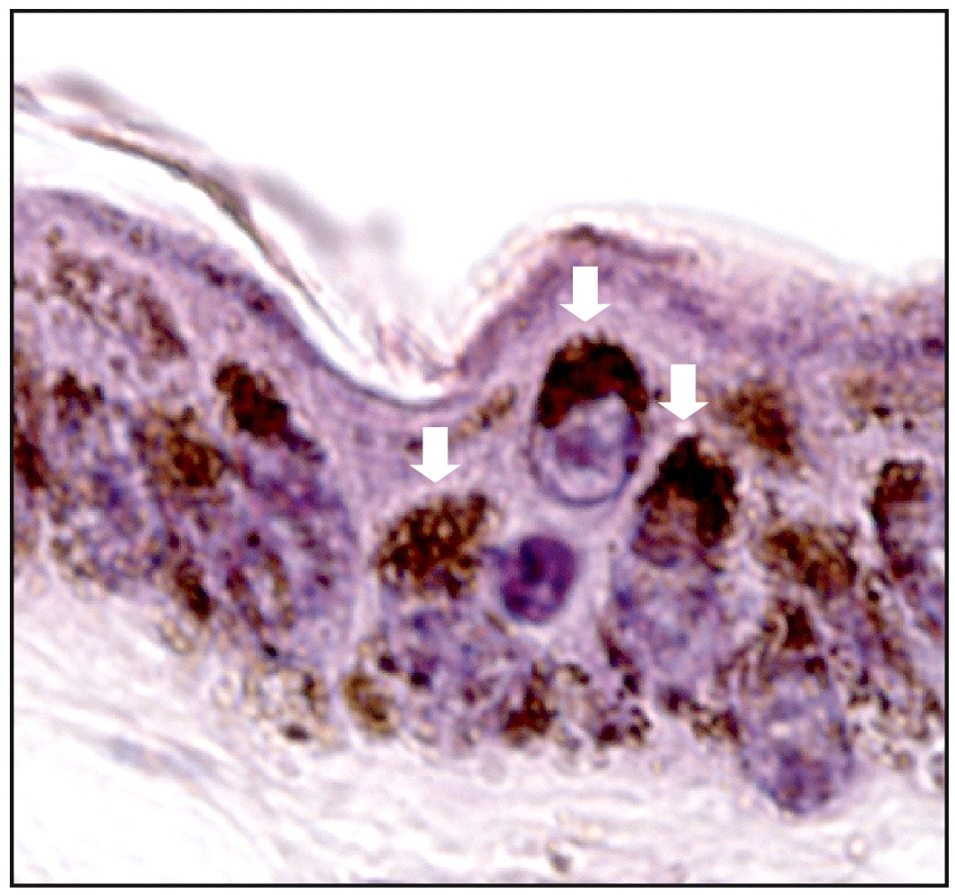
Figure 12.20 The Biology of Cancer (© Garland Science 2007)
Notes:
24

Slide 25
Populations living in highest sun regions have evolved the highest levels of melanin---darkest skin, most protection from UV.
If people living near equator do get skin cancer, it is usually limited to unpigmented regions (soles of feet).

Slide 26
So is some tanning actually good for us? To increase melanin?
Experts say no. When melanocytes/keratinocytes respond they have been penetrated/damaged by UV.
Link of skin cancer to UV is unquestionable. Link of UV to protection against other diseases is suggestive, but not as well supported.

Slide 27
Artificial UV blocking…
Shade/avoidance
Clothing
Sunscreens
Physical—zinc oxide, titanium oxide (reflect UV)
Chemical—PABA, other UV absorbers

Slide 28
Note that sunglasses, sunscreen, and sun protection clothing usually list the UV type they protect against.
https://www.prevention.com/beauty/skin-care/g20174383/best-sunscreens/

Slide 29
UV and Vitamin D
Cells triggered to produce Vitamin D3 when exposed to sunlight.
People in Northern latitudes often low in Vitamin D, due to reduced exposure to sunlight.
Seems to be a growing health issue. Some question of reducing UV exposure too much.

Slide 30
Vitamin D—health benefits are hotly debated. Read carefully.
It helps improve muscle strength and immune function.
It helps reduce inflammation.
It promotes the absorption of calcium from the small intestine.
It helps maintain adequate blood levels of the calcium and phosphate needed for bone formation, mineralization (incorporating minerals to increase strength and density), growth, and repair

Slide 31
General exposure recommendation
10-30 minutes of sun, without sunblock, 3X a week for Caucasians. Difficult in winter months in some areas!
Vitamin D supplements/Pills. Vitamin D is not water soluble, so monitor dosage carefully.
http://www.cancer.gov/cancertopics/factsheet/prevention/vitamin-D

Slide 32
Ionizing radiation
Higher energy than UV. Penetrates into body
Strips electrons from biomolecules (makes ions)
Creates mutagens—interact with and alter DNA

Slide 33
X-rays
Discovered accidently by Wilhelm Roentgen
Working with cathode ray tube which leaked and noted a glowing on a screen across the room
Asked his wife to block the new energy with her hand---gave an image of the bones on the screen!
Nobel prize-1901

Slide 34
Link to cancer
First recognized in X-ray workers (early radiologists)
Burns in exposed skin
High rates of cancer in most exposed areas and in stem cells (leukemia)
Important technology, but must be weighed against risk to DNA damage.

Slide 35
X-rays strip electrons from water molecules
Create free radicals generate reactive oxygen species (ROS)
ROS damage DNA by altering bases and by inducing single and double-strand breaks
May be repaired incorrectly
May initiate DNA rearrangement (chromosome translocation)

Slide 36
Effect of OH radicals (OH*)
Base damage—leads to changes in base sequence after replication.
Figure 6-11

Slide 37
Direct DNA damage
6-11
Strong link to leukemia—associated with specific chromosomal translocations.

Slide 38
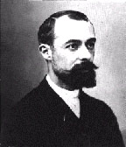
Radioactive elements
Some elements have unstable nuclei—emit energy when they lose different types of particles.
Discovered by Henri Becquerel at nearly the same time as X-ray discovery.

Slide 39
Becquerel was working with a uranium compound. Shared a Nobel prize with the Curies.
Now one accepted international measurement of radioactive decay=Bq

Slide 40
Curie Family
Discovered 2 other radioactive elements polonium and radium.
Marie awarded 2 Nobel prizes (physics and chemistry)
Both her husband, Pierre and her daughter, Irene, worked on radioactivity
Marie and her daughter suffered radiation burns and died of cancer

Slide 41
Types of nuclear radiation/decay/particles
Alpha (α) particle—positively charged--Atom loses 2 protons + 2 neutrons (helium nucleus)
Beta (β) particle—negatively charged—Atom loses electron
Gamma (γ) particle—neutral , high energy photon

Slide 42
Ability to damage tissues
Radioactivity is measured in several ways.
Elctron volt (eV) =overall energy
Bq (becquerel)= rate of decay
Gray (Gy)= energy absorbance (in biological tissues)
Relative biological effectiveness (RBE)=correction factor for Gy based on experimental exposures.
Gy x RBE= sievert (Sv)
X-rays, β and γ−−about equal in RBE
α−−highest RBE—about 20X more damaging.

Slide 43
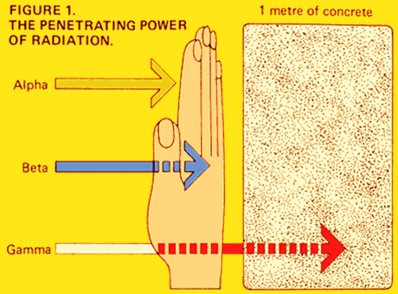
Penetrating capability is related to ability to cause DNA damage

